Slide 1

Chapter 12
Streams and File I/O
Copyright © 2017 Pearson Education, Ltd. All rights reserved.

Slide 2
Learning Objectives
I/O Streams
File I/O
Character I/O
Tools for Stream I/O
File names as input
Formatting output, flag settings
Stream Hierarchies
Preview of inheritance
Random Access to Files

Slide 3
Introduction
Streams
Special objects
Deliver program input and output
File I/O
Uses inheritance
Not covered until chapter 14
File I/O very useful, so covered here

Slide 4
Streams
A flow of characters
Input stream
Flow into program
Can come from keyboard
Can come from file
Output stream
Flow out of program
Can go to screen
Can go to file

Slide 5
Streams Usage
We’ve used streams already
cin
Input stream object connected to keyboard
cout
Output stream object connected to screen
Can define other streams
To or from files
Used similarly as cin, cout

Slide 6
Streams Usage Like cin, cout
Consider:
Given program defines stream inStream that comes from some file: int theNumber; inStream >> theNumber;
Reads value from stream, assigned to theNumber
Program defines stream outStream that goes to some file outStream << "theNumber is " << theNumber;
Writes value to stream, which goes to file

Slide 7
Files
We’ll use text files
Reading from file
When program takes input
Writing to file
When program sends output
Start at beginning of file to end
Other methods available (e.g., random access)
We’ll discuss this simple text file access here

Slide 8
File Connection
Must first connect file to stream object
For input:
File → ifstream object
For output:
File → ofstream object
Classes ifstream and ofstream
Defined in library <fstream>
Named in std namespace
Notes:
cin 就是 istream 的 object

Slide 9
File I/O Libraries
To allow both file input and output in your program: #include <fstream> using namespace std; OR #include <fstream> using std::ifstream; using std::ofstream;

Slide 10
Declaring Streams
Stream must be declared like any other class variable: ifstream inStream; ofstream outStream;
Must then "connect" to file: inStream.open("infile.txt");
Called "opening the file”
Uses member function open
Similar to fopen(filePtr,“infile.txt”)
Can specify complete pathname

Slide 11
Streams Usage
Once declared → use normally! int oneNumber, anotherNumber; inStream >> oneNumber >> anotherNumber;
Output stream similar: ofstream outStream; outStream.open("outfile.txt"); outStream << "oneNumber = " << oneNumber << " anotherNumber = " << anotherNumber;
Sends items to output file

Slide 12
File Names
Programs and files
Files have two names to our programs
External file name
Also called "physical file name"
Like "infile.txt"
Sometimes considered "real file name"
Used only once in program (to open)
Stream name
Also called "logical file name"
Program uses this name for all file activity

Slide 13
Closing Files
Files should be closed
When program completed getting input or sending output
Disconnects stream from file
In action: inStream.close(); outStream.close();
Note no arguments
Similar to fclose(filePtr);
Files automatically close when program ends

Slide 14
File Flush
Output often "buffered"
Temporarily stored before written to file
Written in "groups"
Occasionally might need to force writing: outStream.flush();
Member function flush, for all output streams
All buffered output is physically written
Closing file automatically calls flush()

Slide 15
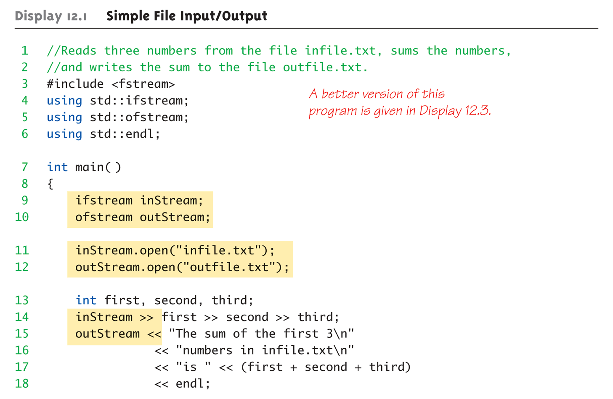
File Example: Display 12.1 Simple File Input/Output (1 of 2)

Slide 16
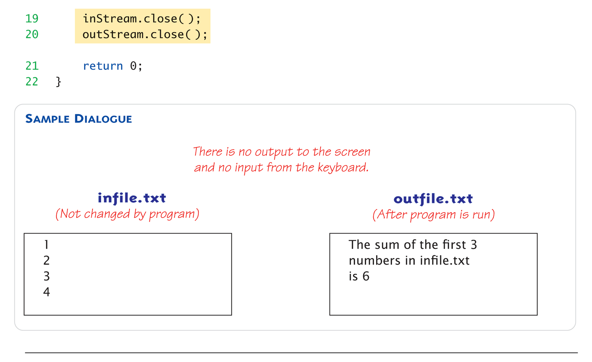
File Example: Display 12.1 Simple File Input/Output (1 of 2)

Slide 17
Appending to a File
Standard open operation begins with empty file
Even if file exists → contents lost
Open for append: ofstream outStream; outStream.open("important.txt", ios::app);
If file doesn’t exist → creates it
If file exists → appends to end
2nd argument is class ios defined constant
In <iostream> library, std namespace
Useful for log file

Slide 18
Alternative Syntax for File Opens
Can specify filename at declaration
Passed as argument to constructor
ifstream inStream; inStream.open("infile.txt"); EQUIVALENT TO: ifstream inStream("infile.txt");

Slide 19
Checking File Open Success
File opens could fail
If input file doesn’t exist
No write permissions to output file
Unexpected results
Member function fail()
Place call to fail() to check stream operation success inStream.open("stuff.txt"); if (inStream.fail()) { cout << "File open failed.\n"; exit(1); }

Slide 20
Character I/O with Files
All cin and cout character I/O same for files!
Member functions work same:
get, getline
put, putback,
peek, ignore

Slide 21
Checking End of File
Use loop to process file until end
Typical approach
Two ways to test for end of file
Member function eof() inStream.get(next); while (!inStream.eof()) { cout << next; inStream.get(next); }
Reads each character until file ends
eof() member function returns bool
while (!inStream.eof()) {
inStream.get(next); cout << next; }
Notes:
100 20 200 1000 19 95 29 39 18 16 '\n’
若是檔案結尾最後還有一個斷行符號，右邊的會出錯，會多出一次

Slide 22
End of File Check with Read
Second method
read operation returns bool value! (inStream >> next)
Expression returns true if read successful
Returns false if attempt to read beyond end of file
In action: double next, sum = 0; while (inStream >> next) sum = sum + next; cout << "the sum is " << sum << endl;

Slide 23
End of File Check with Read
Second method
read operation returns bool value! (inStream >> next)
Expression returns true if read successful
Returns false if attempt to read beyond end of file (??)
In action: double next, sum = 0; while (inStream >> next) sum = sum + next; cout << "the sum is " << sum << endl;

Slide 24
How?
Use operator bool() to define the conversion
class myType{
public:
int a;
operator bool() const { return a != 0;}
};
int main()
{
myType var;
var.a = 1;
while (var){
cout << "oh" << endl;
char c;
cin >> c;
}
return 0;
}

Slide 25
Remind
The type checking of C++ is more restrict than that of C
Demonstrate

Slide 27
Tools: File Names as Input
Stream open operation
Argument to open() is string type
Can be literal (used so far) or variable char fileName[16]; // or string fileName; ifstream inStream; cout << "Enter file name: "; cin >> fileName; inStream.open(fileName);
Provides more flexibility

Slide 28
Formatting Output with Stream Functions
Recall chapter 1 "magic formula": cout.setf(ios::fixed); cout.setf(ios::showpoint); cout.precision(2);
Outputs numbers in "money" form (12.52)
Can use on any output stream
File streams have same member functions as cout object
Notes:
也可以用在不同的 output stream 上面

Slide 29
Output Member Functions
Consider: outStream.setf(ios::fixed); outStream.setf(ios::showpoint); outStream.precision(2);
Member function precision(x)
Decimals written with "x" digits after decimal
Member function setf()
Allows multitude of output flags to be set

Slide 30
More Output Member Functions
Consider: outStream.width(5); cout << 10 << endl;
Output: “ 10”
Member function width(x)
Sets width to "x" for outputted value
Only affects "next" value outputted
Must set width before each value in order to affect all
Typical to have "varying" widths
To form "columns”

Slide 31
Flags
Recall: member function setf()
Sets condition of output flags
All output streams have setf() member
Flags are constants in class ios
In library <iostream>, std namespace
std::ios::fixed, std::ios::showpoint, …

Slide 32
setf() Examples
Common flag constants:
outStream.setf(ios::fixed);
Sets fixed-point notation (decimal)
outStream.setf(ios::showPoint)
Always include decimal point
outStream.setf(ios::right);
Sets right-justification
Set multiple flags with one call: outStream.setf(ios::fixed | ios::showpoint | ios::right);
Remark that unsetf(xxx) can unset the flag
Notes:
如果你有使用 width，ios::right 是自動對齊右邊

Slide 33
Manipulators
Manipulator defined: "A function called in nontraditional way"
Can have arguments
Placed after insertion operator
Do same things as member functions!
In different way
Common to use both "together"
setw() and setprecision() are in library <iomanip>, std namespace
Notes:
特殊的 function，可以放在 operator 後面
例如：endl 可以放在 cout << 後面，其實也能 endl(cout);

Slide 34
Manipulator Example: setw()
setw() manipulator: cout << "Start" << setw(4) << 10 << setw(4) << 20 << setw(6) << 30;
Results in: Start 10 20 30
Note: setw() affects only NEXT outputted value
Must include setw() manipulator before each outputted item to affect all

Slide 35
Manipulator setprecision()
setprecision() manipulator: cout.setf(ios::fixed | ios::showpoint); cout << "$" << setprecision(2) << 10.3 << " " << "$" << 20.5 << endl;
Results in: $10.30 $20.50

Slide 36
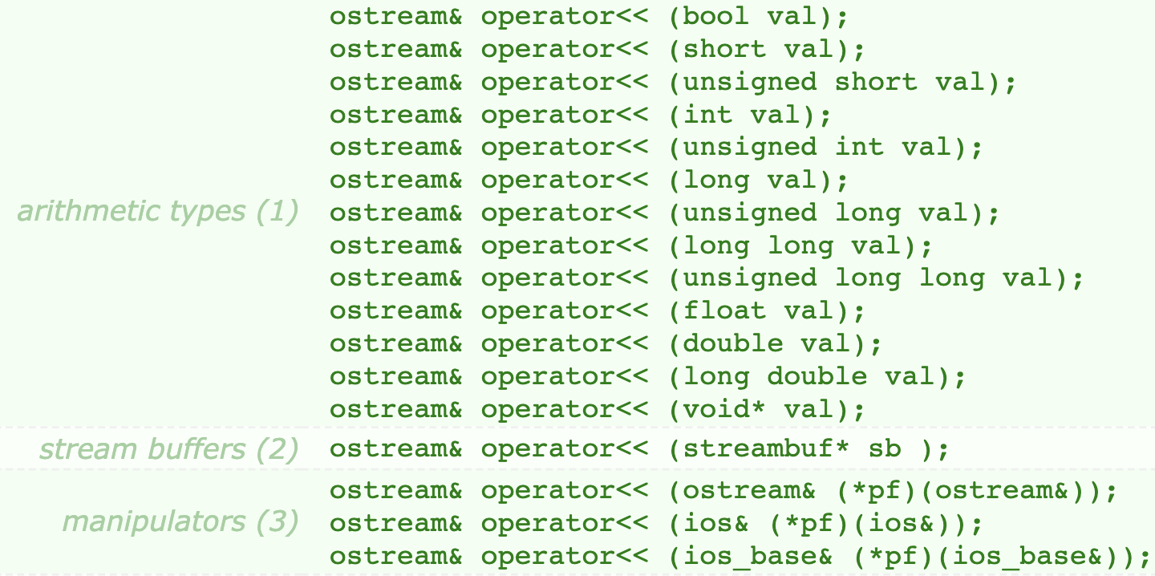
Overloaded Operator <<
Notes:
可以看到 << 的右邊可以是 bool, int, …常見的 variable type
也可以是 function pointer

Slide 37
Saving Flag Settings
Flag settings "stay" until changed
Precision and setf flags can be saved and restored
Function precision() returns current setting if called with no arguments
Member function flags() provides similar capability

Slide 38
Saving Flag Settings Example
void outputStuff(ofstream& outStream) { int precisionSetting = outStream.precision(); //save long flagSettings = outStream.flags(); outStream.setf(ios::fixed | ios::showpoint); outStream.precision(2); // Do whatever you want here. outStream.precision(precisionSetting); //restore outStream.flags(flagSettings); }

Slide 39
Restoring Default setf Settings
Can also restore default settings: cout.setf(0, ios::floatfield);
Not necessarily the "last" setting!
Default values are implementation- dependent
Does not reset precision settings
Only setf settings

Slide 41
Stream Hierarchies
Class Relationships
"Derived from"
One class obtained from another class
Then features are "added"
Example:
Input file streams class is derived from class of all input streams
It then adds open and close member functions
i.e.: ifstream is derived from istream

Slide 42

Class Inheritance "Real" Example
Class of all convertibles is derived from class of all automobiles
Every convertible is an automobile
Convertible "adds features" to automobile
Notes:
Convertible
Automobile

Slide 43
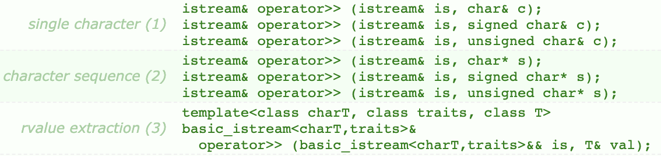
Stream Class Inheritance
Consider:
If D is derived class of class B →
All objects of type D are also of type B
e.g., A convertible is also an automobile
Regarding streams:
An ifstream object is also an istream object
Should use istream objects for parameters
More objects can be plugged in! (see next page)

Slide 44
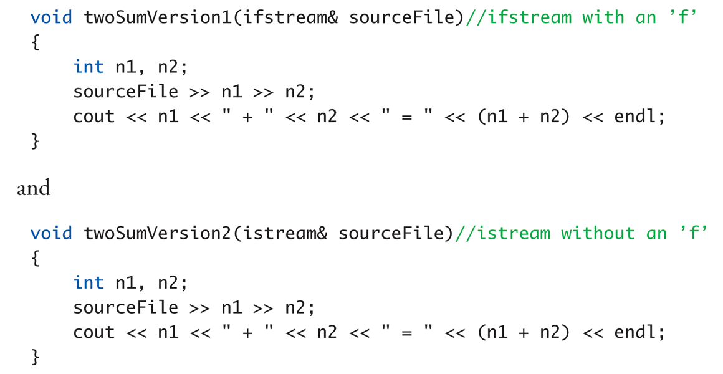
Stream Class Inheritance Example

Slide 45
Stream Class Inheritance Example Calls
Considering previous functions:
twoSumVersion1(fileIn); // Legal!
twoSumVersion1(cin); // ILLEGAL!
Because cin is not of type ifstream!
twoSumVersion2(fileIn); // Legal!
twoSumVersion2(cin); // Legal!
More versatile
istream parameter accepts both objects

Slide 47
stringstream
The stringstream class is another example of inheritance
Derived from the iostream class
Allows you to perform stream operations to or from a string, similar to how you perform stream operations from cin or from a file (i.e., >> and <<)
Shares or inherits the same methods
Useful for converting strings to other data types and vice versa

Slide 48
stringstream

Slide 49
Using stringstream
To use
#include <sstream>
using std::stringstream;
Create an object of type stringstream
stringstream ss;
To clear and initialize to blank
ss.clear( );
ss.str("");
To create a string from other variables
ss << c << " " << num; // c is a char, num is an int

Slide 50
Using stringstream
To extract variables from a string
// ss is "x 10” now
ss >> c >> num;
// c is set to 'x' and num is set to 10
This class is sometimes useful when reading a string from some source and extracting fields from the string
Notes:
有點像 c 的 sscanf 和 sprintf

Slide 51
stringstream Demo (1 of 3)
//Demonstration of the stringstream class. This program takes
//a string with a name followed by scores. It uses a
//stringstream to extract the name as a string, the scores
//as integers, then calculates the average score. The name
//and average are placed into a new string.
#include <iostream>
#include <string>
#include <sstream>
using namespace std;
int main( )
{
stringstream ss;
string scores = "Luigi 70 100 90";

Slide 52
stringstream demo (2 of 3)
// Clear the stringstream
ss.str("");
ss.clear();
// Put the scores into the stringstream
ss << scores;
// Extract the name and average the scores
string name = "";
int total = 0, count = 0, average = 0;
int score;
ss >> name; // Read the name
while (ss >> score) // Read until the end of the string
{
count++;
total += score;
}

Slide 53
stringstream demo (3 of 3)
if (count > 0)
{
average = total / count;
}
// Clear the stringstream
ss.clear();
ss.str("");
// Put in the name and average
ss << "Name: " << name << " Average: " << average;
// Output as a string
cout << ss.str() << endl;
return 0;
}
Name: Luigi Average: 86

Slide 55
Random Access to Files
Sequential Access
Most commonly used
Random Access
Rapid access to records
Perhaps very large database
Access "randomly" to any part of file
Use fstream objects
input and output
Notes:
fstream 可以做 input 也可以做 output

Slide 56
fstream

Slide 57
Random Access Tools
Opens same as istream or ostream
Adds second argument
fstream rwStream; rwStream.open("stuff", ios::in | ios:: out);
Opens with read and write capability
Move about two pointers in file
rwStream.seekp(1000);
Positions put-pointer at 1000th byte
rwStream.seekg(1000);
Positions get-pointer at 1000th byte
Notes:
Open 的時候可以加上你是否要 input or output，可以兼有
可以個別移動兩個 pointers

Slide 58
Random Access Sizes
To move about → must know sizes
sizeof() operator determines number of bytes required for an object: sizeof(s) //Where s is string s = "Hello" sizeof(10) sizeof(double) sizeof(myObject)
Position put-pointer at 100th record of objects: rwStream.seekp( ( 100 – 1 )*sizeof(myObject) );

Slide 59
Random Access Sizes
To move about → must know sizes
sizeof() operator determines number of bytes required for an object: sizeof(s) //Where s is string s = "Hello" sizeof(10) sizeof(double) sizeof(myObject)
Position put-pointer at 100th record of objects: rwStream.seekp( ( 100 – 1 )*sizeof(myObject) );

Slide 60
Summary 1
Streams connect to files with open operation
Member function fail() checks successes
Stream member functions format output
e.g., width, setf, precision
Same usage for cout (screen) or files
Stream types can be formal parameters
But must be call-by-reference

Slide 61
Summary 2
istream (no "f") parameters accept cin or ifstream objects as arguments
ostream (no "f) parameters accept cout or ofstream objects as arguments
Member function eof
Used to test for end of input file
Streams use inheritance to share common methods and variables in an “is-a” relationship between classes

